Slide 1
Geothermal powerplant
Report 1. aya mohamed sayed . sec 1. b.no 9

Slide 2
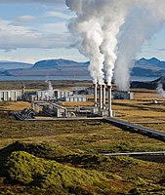
What is geothermal energy
Geothermal energy is an alternative ,clean and renewable energy source , which is high thermal energy of natural origin stored in magma in the ground . Where it is estimated that more than 99% of the Earth's mass is rocks whose temperature exceeds 1000 degrees Celsius . The temperature rises as we go deeper into the earth's core, at a rate of about 2.7 degrees Celsius for every 100 meters in depth, that is, it reaches an average of 27 degrees Celsius at a depth of one kilometer or 55 degrees at a depth of two kilometers, and so on. And take advantage of this Thermal energy is mainly used to generate electricity , and this requires digging many pipes to abysmal depths that may reach about 5 kilometers. Sometimes hot water is used for heating when the temperature is close to the surface of the earth , and we find it at a depth of 150 meters or sometimes in certain areas in the form of hot springs that reach the surface of the earth . ￼

Slide 3
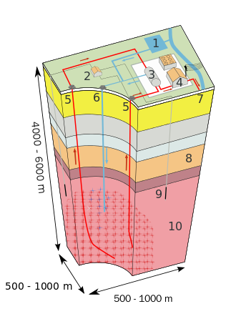
Geothermal energy
This renewable energy, in theory, could be sufficient to cover the world's energy needs for the next 100,000 years, but converting it into electric energy is an expensive process due to drilling operations to great depths and the need for many pipes to extract hot water in abundant quantities, although the basic energy ( The raw material) is free and is widely available, but difficult to obtain.

Slide 4
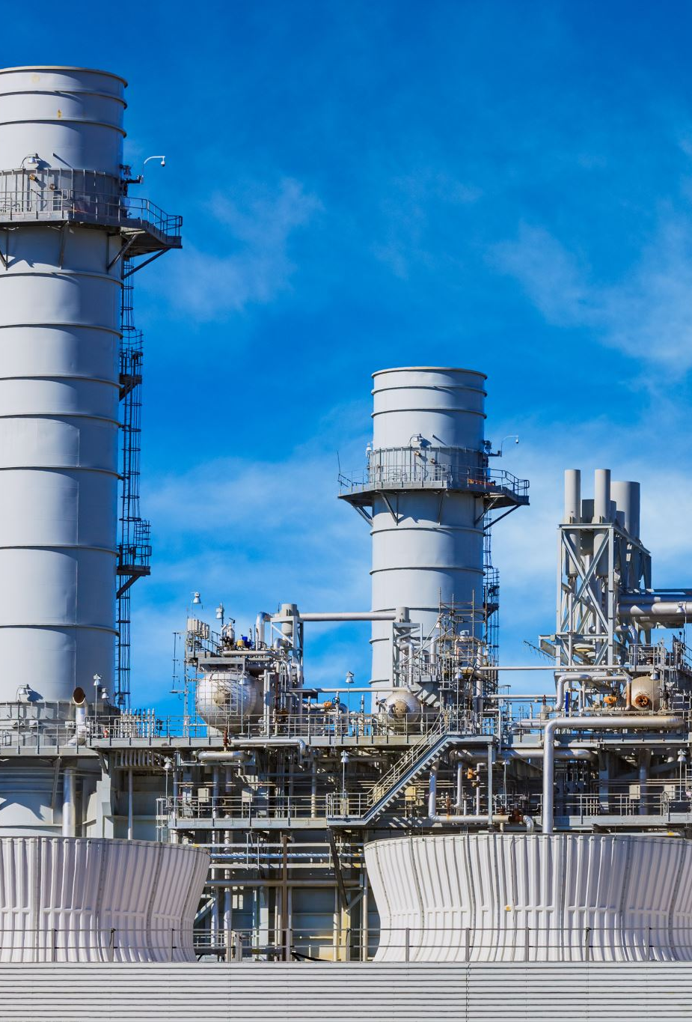
The source of geothermal energy
The sources of obtaining geothermal energy are divided into two parts: underground hot water and hot rocks that are found in volcanically active areas or in the distant depths under the surface of the earth . Many other fields of industry and agriculture

Slide 5
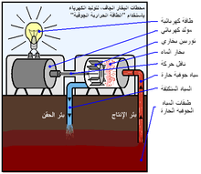
Generation of electricity using geothermal energy
The first and most important way to benefit from geothermal energy is to convert it into electrical energy , and this is done in power plants using geothermal energy. There are three types of power plants using geothermal energy, as follows: Dry steam plants: This method is the oldest and most widespread method, and it is the same method . These stations use water that is naturally present in the deep layers of the earth and is under the influence of high pressure and temperature . It is extracted by drilling deep wells, and it comes out in the form of water vapor because of its high temperature and because of the pressure difference . This steam travels in tubes and is then exposed to turbines that rotate electric generators that produce electrical energy . The condensate water is pumped to the ground through another well called the injection well. fumigation stations: These stations use underground high- pressure liquids where they are concentrated in a container with a small hole that leads to another container with moderate pressure . When the liquid moves from the first container to the second through the hole, it evaporates due to the speed and the high pressure difference . The steam drives the turbine , which in turn drives the electric generators that produce electricity . The remaining condensate water is pumped to the ground through the injection well.

Slide 6
Advantage of geothermal energy
Among the most important advantages of this energy: 1-Being a renewable energy , it is one of the sources of energy that does not run out at least for future generations. 2-Being a clean energy that is not harmful to the environment , and does not cause any pollution , whether in its extraction, conversion or use. It is available in very large quantities and in vast areas and for most countries of the world. 3-Less energy production costs beyond the initial costs of producing the plant (which can be prohibitive). 4-High yield of extracted energy.

Slide 7
Disadvantage of geothermal energy
Despite all the advantages of geothermal energy, which made it at the forefront of future alternative energy sources, there are some factors that make it difficult to spread, at least at the present time. Among the most important of these reasons is the high cost of establishing power plants using geothermal energy. The reason for this is due to the difficulty of drilling wells at abysmal depths that may reach a depth of 5 kilometers, amid high temperatures and in large numbers that allow the establishment of a medium-capacity power station.

